Slide 1
Revision & Exam Technique
Surviving Easter Term

Slide 2
Phases of Exam Season

Slide 3
Phases of Exam Season
Pre-Revision

Slide 4
Phases of Exam Season
Pre-Revision
Revision

Slide 5
Phases of Exam Season
Pre-Revision
Revision
Exam Period

Slide 6
Phases of Exam Season
Pre-Revision
Revision
Exam Period
Exam Writing

Slide 7
Pre-revision
Phase 1

Slide 8
Pre-Revision: Step 1

Slide 9
Pre-Revision: Step 1

Slide 10
Pre-Revision: Step 1
For at least a week do not even think about philosophy
There are 10 weeks between now and the start of the exam period (24 May)
13 weeks until the end of Easter Term
Think of this like a marathon.

Slide 11
Pre-Revision: Step 2

Slide 12
Pre-Revision: Step 2

Slide 13
Pre-Revision: Step 2
Plan your revision schedule
Figure out how much time you have between now and each of your exams
Decide how much time to devote to each
Decide roughly when you’re going to revise each paper
**Set realistic goals!**
Keep this plan somewhere visible and accessible

Slide 14
revision
Phase 2

Slide 15
Revision: Consolidating Knowledge
Synthesise your notes into study guides
Gather all your notes from lectures, supervisions and readings
Imagine you are writing an SEP article on each topic

Slide 16
Revision: Consolidating Knowledge
Ask yourself…
What are the relevant positions?
Argument?
Objections?
What is the question to which the answer is one of these positions?
What is the dialectic? (How do the positions and corresponding objections relate to one another?)

Slide 17
Revision: Practice Questions
Practice with past exam questions
You do not have to write out entire essays! (In fact, I recommend against doing this.)
Put together essay skeletons – detailed sketches of essays

Slide 18
Revision: Practice Questions
Essay skeletons should include…
Thesis
Premises that entail thesis
Objections and Replies
‘Discuss X. Respond to Y. Conclude Z’ is not sufficient
A skeleton should be the kind of thing that, if written out in sentence (rather than bullet) form, would constitute an essay

Slide 19
Revision: Practice Questions
Be warned!
The papers have changed over the years; if you see an unfamiliar topic, check the current reading list (exams questions are constrained by the reading list)
DO NOT write and memorise essays in order to use at the exam. Essay-dumping is severely penalised.

Slide 20
Revision: Note storage
Create backups!
If your notes are on the computer, save them in multiple places.
If they are on paper, make copies or at least use page sleeves.
*You do not want something as little as a coffee spill to derail your exams. Accident-proof your notes.*

Slide 21
Revision: Study Groups
Your mileage may vary

Slide 22
Revision: Study Groups
Work together
Things to do in a study group…
Compare ‘encyclopedia’ study guides
Trade questions
Discuss gaps in your understanding

Slide 23
Revision: Study Groups
Work together
Things to do in a group of people studying
Plan to start and/or finish studying in the same place at the same time
Take regular breaks together
Discuss your plans for the day

Slide 24
Revision: Healthy Routines
Structure your day
Whether you’re a morning person or a late-riser, set a feasible daily wake-up time and stick to it
Break each day into small blocks (including break blocks)
Set yourself small block-sized tasks for each block
Schedule in…
7-8hrs sleep
Social time (group study does not count!)
Exercise (even if that’s just a daily walk)

Slide 25
Revision: Healthy Routines
Structure your day
Find a few different locations that are conducive to your work style
Ideally, keep your room (or at least your bed) only for resting
Don’t be afraid to change locations a few times throughout your work day (a change of scene can help break up the monotony)

Slide 26
Revision: Etiquette
Things to avoid…

Slide 27
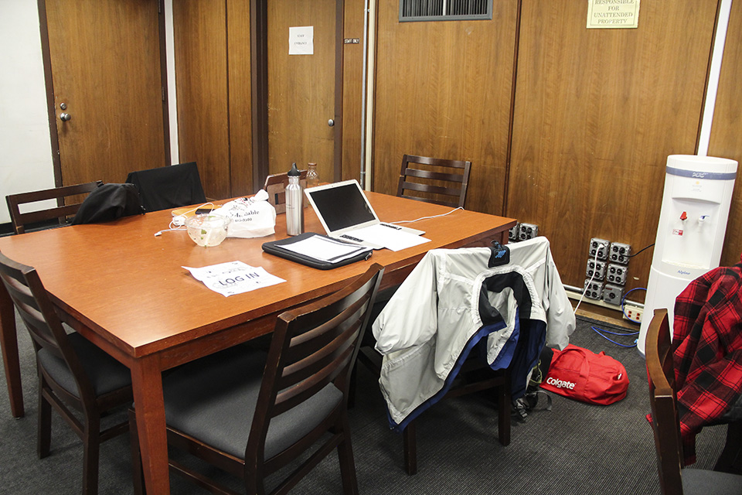
Revision: Etiquette
“Dibs”-ing

Slide 28
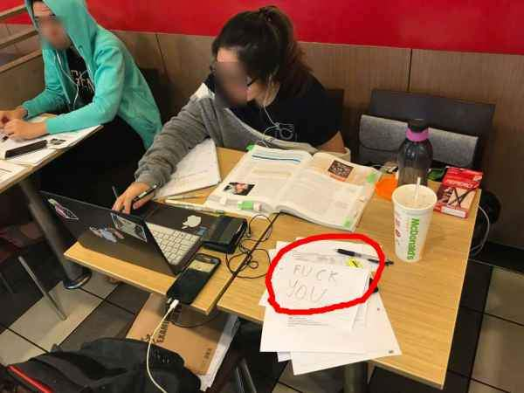
Revision: Etiquette
Sprawl

Slide 29
Revision: Etiquette
“i needs ALL deez”

Slide 30
Revision: Etiquette
“I’ve been in the [work space] [inhuman number of hrs]!”

Slide 31
Revision: Etiquette
“Nah, I barely studied” …*studies daily*

Slide 32
Exam Period
Phase 3

Slide 33
Exam period: Change pace
Once your exam period begins (i.e. the period starting from the few days before your first exam and ending after your last) change your pace
Stay well rested throughout
Schedule down-time
Work shorter days
The bulk of your revision should be done by this point. This time is just for brushing up, and taking care of yourself.

Slide 34
Exam writing
Phase 4

Slide 35
Exam writing: Starting the exam
When you begin your exam:
Read every question and identify the ones you can plausibly answer
Pick three and sketch brief outlines (thesis statement, names of arguments, objections replies)
If you struggle to do this kind of sketch for any of them, choose another question and try again
This process should take ~5-10mins

Slide 36
Exam writing: essay planning
Detailed Outlines:
Supposing you have about 55 minutes per essay, you should devote at least 15-20 minutes to planning
Write a detailed essay skeleton
Don’t just start straight into the essay! This will result in a meandering discussion
Do make sure your argument directly answers the question asked

Slide 37
Exam writing: Re-reading your work
It’s tempting to leave all of the re-reading to the end
Try scattering this work throughout the three+ hours
E.g. You might try something like the following:
Plan and write Essay 1
Plan and write Essay 2
Reread Essay 1
Plan Essay 3
Reread Essay 2
Write and Reread Essay 3

Slide 38
Exam writing: General paper
Important things to note:
Your essay does not have to be three times as long – aim for ~2x the length of a standard exam essay
You have to craft your own question
Argument structure is key – it is worth devoting approximately 1 hour to planning your essay in detail
Do not ramble to fill the space!

Slide 39
Good luck everyone! ☺

